Slide 1
GO-MAF
Generated Online – Maintenance Action Form
By: Richard Go, MSSA CAD

Slide 2
Contents
SDLC
Technology Used
Code Walk-through
Product Demonstration

Slide 3
Software Development Life Cycle
Planning
Design
Concept Investigation
Project Selection
DB Design
UI/UX Wireframes
Requirements / Use Cases
Development
ASP.NET MVC
DB Integration
Testing
TDD / TRR
RTM
Entity Framework
CSS & Responsive Design
Deploy to Azure

Slide 4
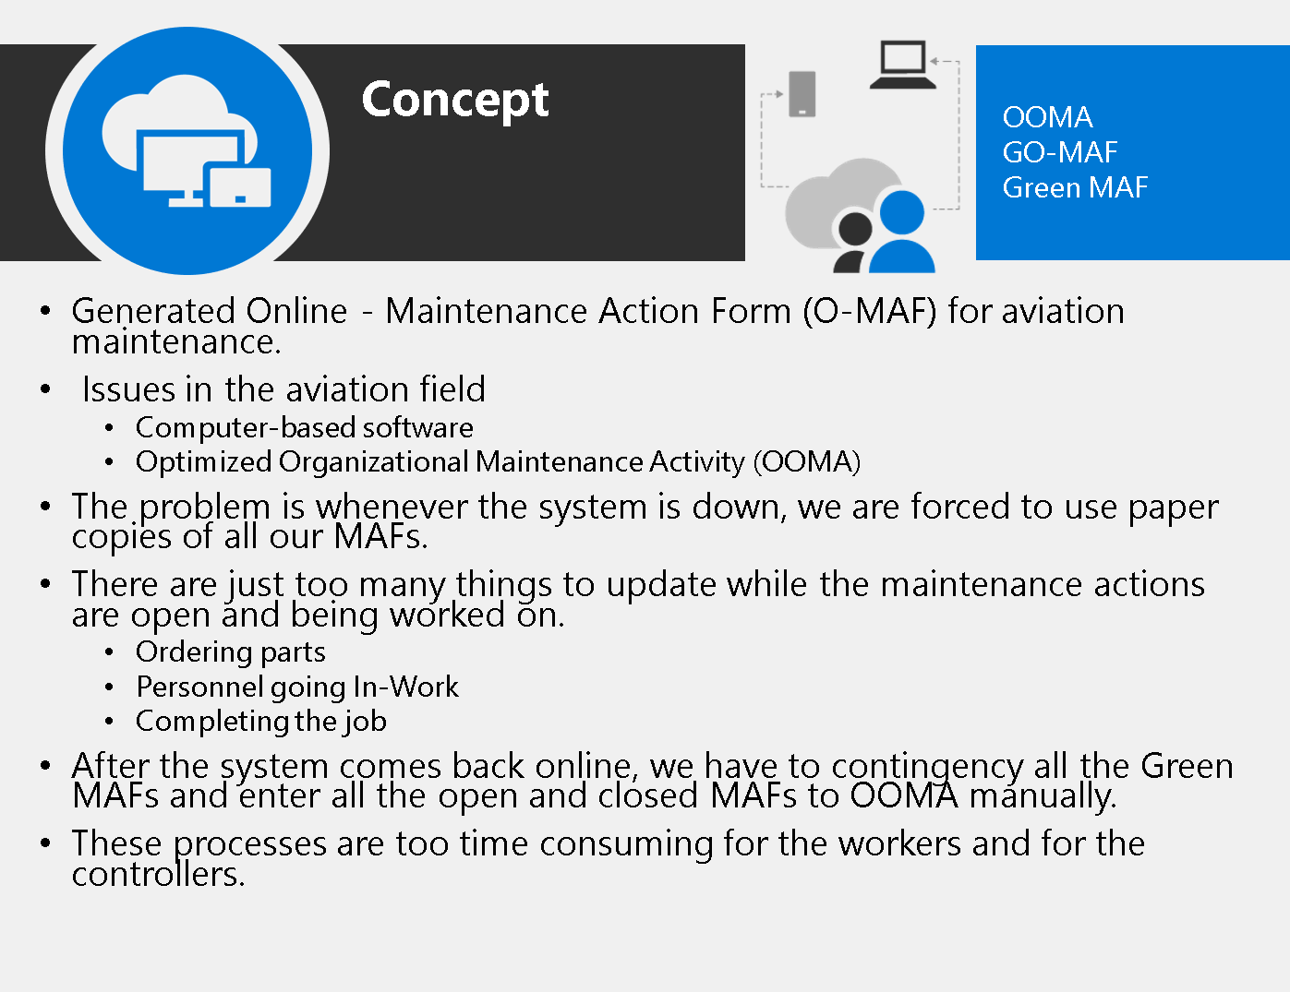
Concept
LSS Study

Slide 5
Lean Six Sigma Studies
Back to SDLC

Slide 6
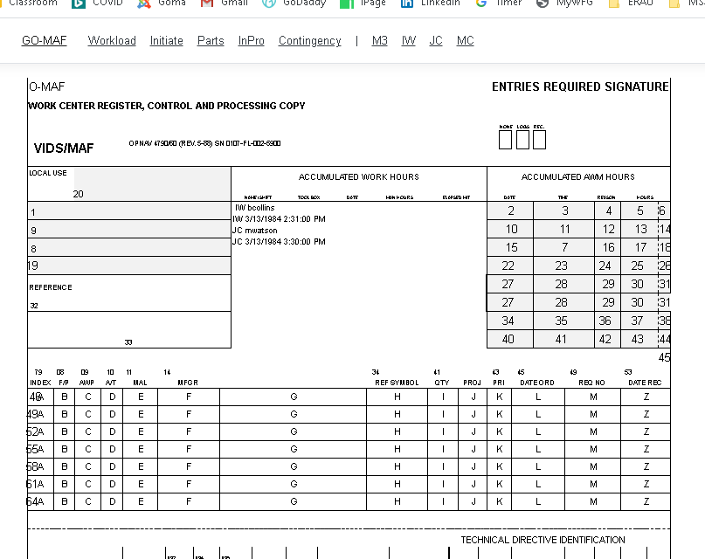
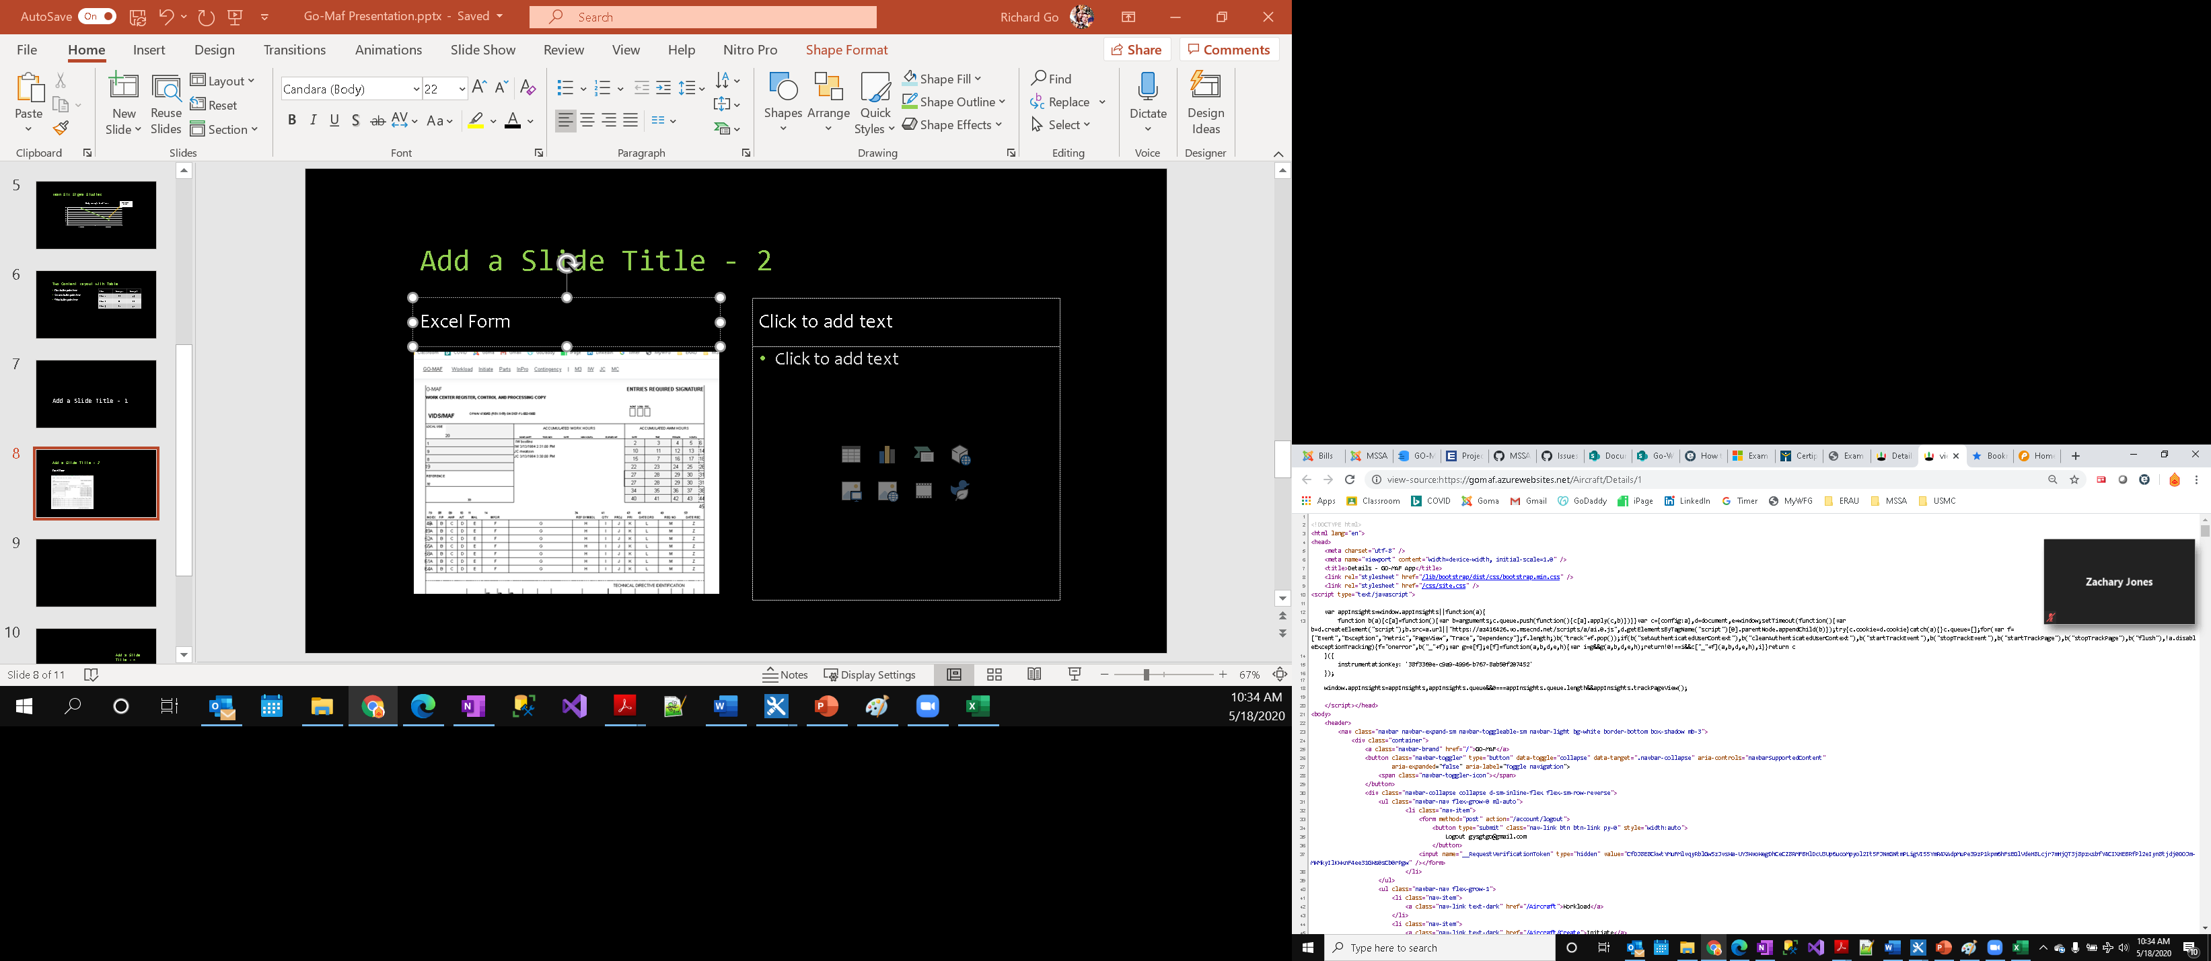
CSS Form
Back to SDLC
Excel Form
View Source

Slide 7
Technology Used
GitHub as the main project management tool.
MVC Movie App from Microsoft docs as the template.
Visual Studio for implementing ASP.NET MVC framework.
Microsoft SQL Server Studio to create database and db schema.
Microsoft.EntityFramework.SqlServer version 3.1.1
https://app.sqldbm.com/SQLServer/Draft/ for creating Entity Relationship Design.
Pencil Project by Evolus to create my wireframe design.
IdentityDbContext for user's login.
Microsoft Excel to build the Details page form.
MSunit Test to validate:
Aircraft object
User object
Published to Azure using:
SQL Database
SQL Server
App Services

Slide 8
Code Walk-through
Models
View
Controllers
[AllowAnonymous]
CSS
Stylesheet.css
Form
M | V | C
Aircraft | Aircraft | AircraftCont
IdentityUser | Search Bar | AccountCont

Slide 9
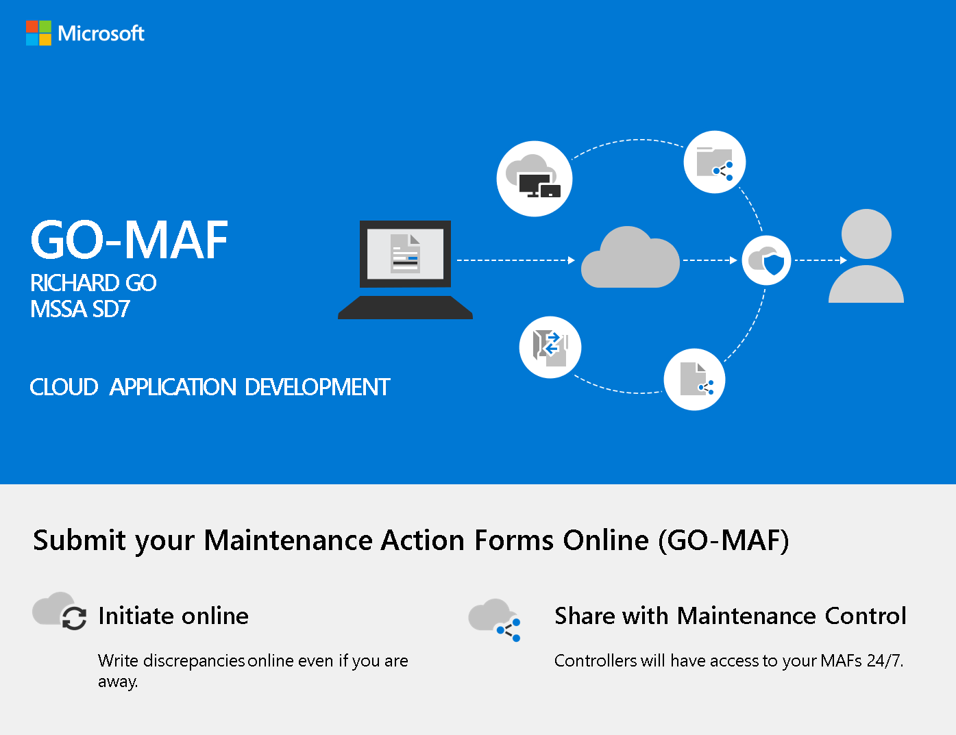
GO-MAF
Product Presentation
Click on image

Slide 10
Questions?...

Slide 11
GO-MAF
Generated Online – Maintenance Action Forms
- Thank you VMM 166 (SeaElk) for giving me the opportunity to attend the MSSA program.

